Slide 1
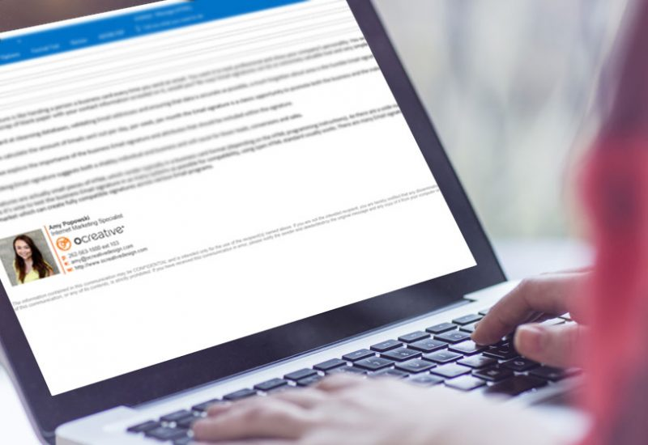
E-mail Signature

Slide 2

What is the Purpose of an E-mail Signature?
Provides essential information for hiring manager to contact you
Essential for effective e-mail communication
Provides legitimacy and professionalism
Serves as a digital business card to connect with others

Slide 3
E-mail Signature Example:
Best regards,
Donna
Donna Harris
dharris@miu.edu
(641) 472-7000 x 4306
https://www.linkedin.com/in/donna-harris-234039244/
www.github.com/xxxxx

Slide 4


Slide 5
Use Your Resume Name
Legal Name: Resume Name:
Juan Pablo Santiago Sanchez Juan Sanchez
Mohamed Farouk Ahmed Elsayed Mohammed “Mo” Elsayed

Slide 6
Closing Salutation – pick one:
Best regards,
Thank you,
All the best,

Slide 7
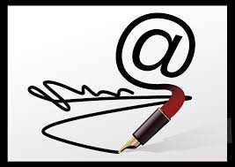
Avoid:
Cheers,
Yours truly,
Love,
Hugs,
Sincerely,
From,

Slide 8

Email Management
You are responsible for monitoring ALL of your e-mail accounts!
The one you used when you applied to MIU (SEVIS requirement)
Your MIU.edu account
Your job search email

Slide 9
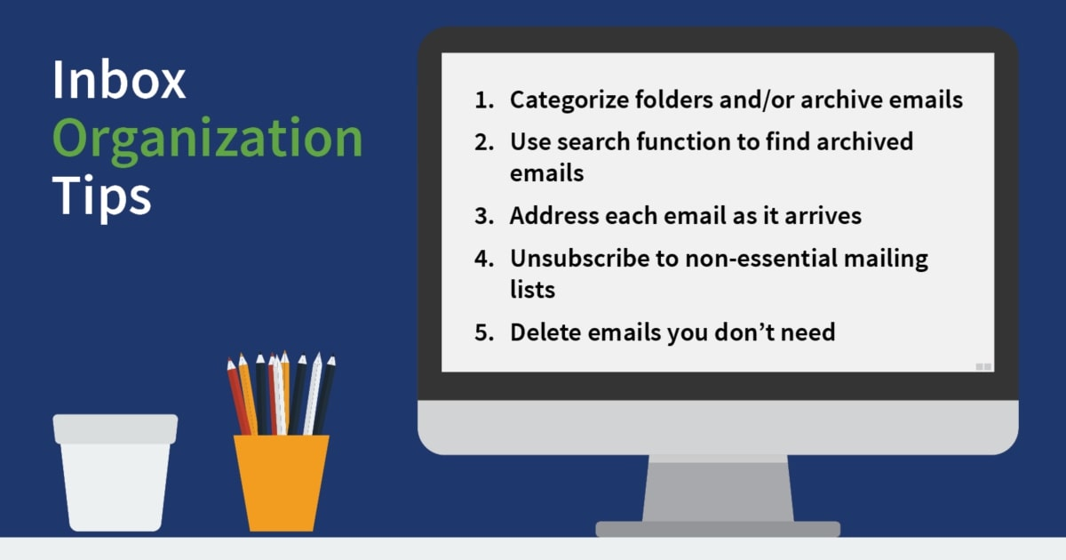
Stay Organized

Slide 10
Make Sure Your Email Signature is Mobile Responsive!
There’s no point in doing all this hard work if your email signature isn’t mobile responsive.
That means that it will look good whether the recipient is reading the email on their desktop, tablet or smartphone.
Wherever they end up looking, your email signature needs to be clear and well-formatted.
That means ensuring your images are the right size and that the email signature template you use will adapt to mobile.
You can create an email signature and quickly test it on your mobile to check it works. Just make sure that wherever recruiters see you, you look good.

